Slide 1
UNIT-I
Machine Learning
TY Btech
Dr. Rashmi Mahajan

Slide 2
Overfitting
The main challenge with overfitting is to estimate the accuracy of the performance of our model with new data. We would not be able to estimate the accuracy until we actually test it.
To address this problem, we can split the initial data set into separate training and test data sets. With this technique, we can actually approximate how well our model will perform with the new data.
Let us understand this with an example, imagine we get a 90+ percent accuracy on the training set and a 50 percent accuracy on the test set. Then, automatically it would be a red flag for the model.

Slide 3
Overfitting
Another way to detect overfitting is to start with a simplistic model that will serve as a benchmark.
With this approach, if you try more complex algorithms you will be able to understand if the additional complexity is even worthwhile for the model or not.
It is also known as Occam’s razor test, it basically chooses the simplistic model in case of comparable performance in case of two models. Although detecting overfitting is a good practice, but there are several techniques to prevent overfitting as well. Let us take a look at how we can prevent overfitting in Machine Learning.

Slide 4
Overfitting
There are several techniques to avoid overfitting in Machine Learning altogether listed below.
Cross-Validation
Training With More Data
Removing Features
Early Stopping
Regularization
Ensembling

Slide 5
Cross Validation
One of the most powerful features to avoid/prevent overfitting is cross-validation. The idea behind this is to use the initial training data to generate mini train-test-splits, and then use these splits to tune your model.
In a standard k-fold validation, the data is partitioned into k-subsets also known as folds. After this, the algorithm is trained iteratively on k-1 folds while using the remaining folds as the test set, also known as holdout fold.

Slide 6
Confusion Metric
A confusion matrix is a table that is often used to describe the performance of a classification model (or "classifier") on a set of test data for which the true values are known. The confusion matrix itself is relatively simple to understand, but the related terminology can be confusing.

Slide 7
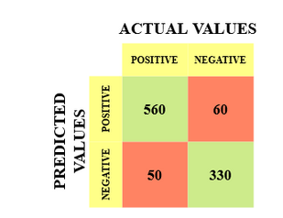
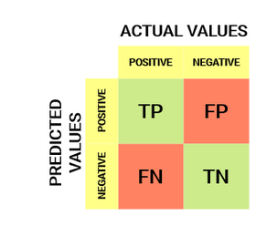
Confusion Metric

Slide 8
Confusion Metric
The target variable has two values: Positive or Negative
The columns represent the actual values of the target variable
The rows represent the predicted values of the target variable

Slide 9
Confusion Matrix
True Positive (TP)
The predicted value matches the actual value
The actual value was positive and the model predicted a positive value
True Negative (TN)
The predicted value matches the actual value
The actual value was negative and the model predicted a negative value
False Positive (FP) – Type 1 error
The predicted value was falsely predicted
The actual value was negative but the model predicted a positive value
Also known as the Type 1 error
False Negative (FN) – Type 2 error
The predicted value was falsely predicted
The actual value was positive but the model predicted a negative value
Also known as the Type 2 error

Slide 10
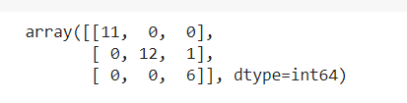
Confusion Matrix
True Positive (TP) = 560; meaning 560 positive class data points were correctly classified by the model
True Negative (TN) = 330; meaning 330 negative class data points were correctly classified by the model
False Positive (FP) = 60; meaning 60 negative class data points were incorrectly classified as belonging to the positive class by the model
False Negative (FN) = 50; meaning 50 positive class data points were incorrectly classified as belonging to the negative class by the model

Slide 11
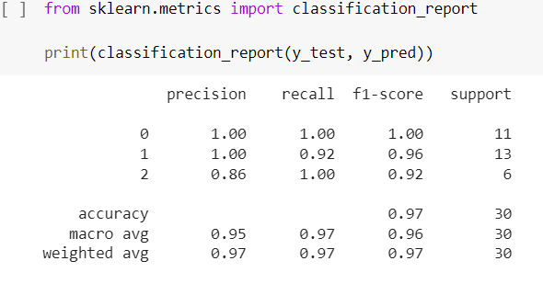
Confusion Matrix

